Slide 1
WATT’S LINKAGE
SLAC2020

Slide 2
GROUP MEMBERS
ABIJITH PRADEEP
ADVAITH D M
C S AYUSH KUMAR
SRINATH MURALI

Slide 3
OUR PROCESS
ANALYSIS
SIMULATION
INTRODUCTION
APPLICATIONS

Slide 4
INTRODUCTION

Slide 5
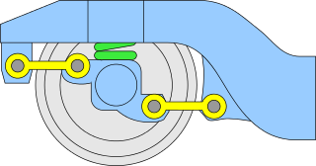
HISTORY OF WATT’S LINKAGE
Watt's linkage is a type of mechanical linkage invented by James Watt in which the central moving point of the linkage is constrained to travel on a nearly straight line. It was described in Watt's patent specification of 1784 for the Watt steam engine.
Watt’s Linkage is a straight line mechanism, Straight line motion mechanisms are mechanisms, having a point that moves along a straight line, or nearly along a straight line, without being guided by a plane surface.
The mechanism was originally designed for steam engine Trains, which later found its application over other mechanical machines like automobiles etc.
Here in our project we consider Watt’s Linkage as a four bar mechanism and perform the necessary analysis.

Slide 6
What is a Mechanism?
And Analysis based of Watt’s Linkage

Slide 7
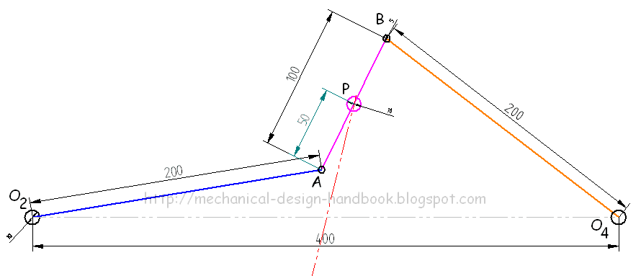
WATT’S MECHANISM AND MOTION
A mechanism is a component of a machine consisting of two or more bodies arranged so that the motion of one compels the motion of the others. In other words it is an assembly of moving parts usually links performing a complete functional motion.
In Watt’s Linkage the functional motion is the straight line curve, and this motion was achieved by James Watt by using Four Links, where three links are moving links and a Fixed Links.
The straight line motion is observed in the central moving link, which can be traced by it mid-point.

Slide 8
Watt’s Linkage
Watt's linkage consists of three bars, bolted together, in a chain. The chain of bars, consists of two end bars, and a middle bar. The middle bar is bolted at each of its ends to one of the ends of each outer bar.
The three bars can pivot around the two bolts. The outer endpoints of the long bars are fixed in place relative to each other, but otherwise the three bars are free to pivot around the two joints where they meet.
In linkage analysis there is an imaginary fixed-length bar connecting between the outer endpoints. Thus Watt's linkage is an example of a four-bar linkage.

Slide 9
GRASHOF’S CRITERION
SYNTHESIS OF WATT’S LINKAGE

Slide 10
Grashof’s Criterion
Our Case
Consider a four-link kinematic chain, let s be the shortest link length, l be the longest link length, p and q be the link lengths of the remaining two links,
where l > p ≥ q > s. Grashof stated that there exists at least one link which can fully revolve with respect to the other three links if, l + s ≤ p + q
In Watt’s Linkage the longest link (l) is the fixed link, shortest link (s) is the coupler, the sum of the these link lengths are greater than the sum of the other links.
Hence we have s+l>p+q, it is a non- grashof mechanism. It is a triple Rocker mechanism.

Slide 11
ANALYSIS
Mobility, Linkage, Angle, Position, Velocity and Acceleration

Slide 12
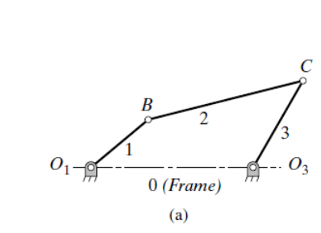
MOBILITY ANALYSIS OF WATT’S LINKAGE
“The Mobility of a chain is defined as the number of degrees of freedom of the chain”
The Mobility is given by the formula
m = 3(n-1) - 2j
Where,
n - Number of links
j - Number of joints
m - Mobility of linkage
Since Watt’s Linkage is a Four Bar mechanism, the number of links n=4
Total Number of Joints j=4
m = 3(4-1) - (2 x 4) = 1
Hence the mobility or the degree of freedom of Watt’s Linkage is 1

Slide 13
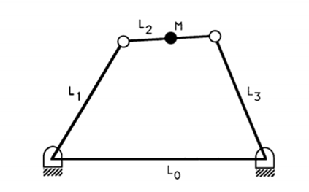
Linkage Analysis
A pictorial representation of Watts Linkage is given here. No link in the watts linkage rotates for more than 360 degrees, unlike the Chebyshev Linkage.
The crank or the coupler is the driver in the Watts Linkage. The output is obtained from the point M located in the middle of the coupler as shown in the figure.
Since its a triple rocker, we have L2+L0 > L1+L3
The Links are denoted as follows:
Fixed Link (Longest) : L0
Driver Link : L1
Coupler Link (Shortest) : L2
Follower Link : L3

Slide 14
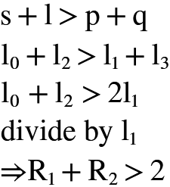
LINK LENGTH LIMITATION FOR WATT’S LINKAGE
Condition 1:
L0 > L1+L3+L2, ie. the mechanism does not exist.
Condition 3:
If Condition 1 is satisfied and links L1 and L3 are equal
From the Non-Grashof’s Conditions.
Condition 2:
L2+L0 > L1+L3, ie. the mechanism has to be a non-grashof’s (s+l>p+q)
SIMULATION LIMITATION: An extra link length constraint was observed and required during computational analysis due to the manual interference in varying corresponding angles, which is given by:
(L1 + L3)-(L0+L3) > 3

Slide 15
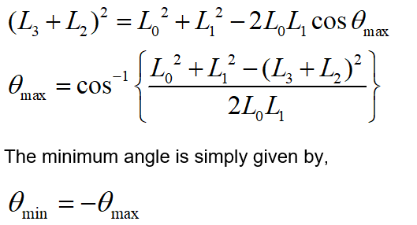
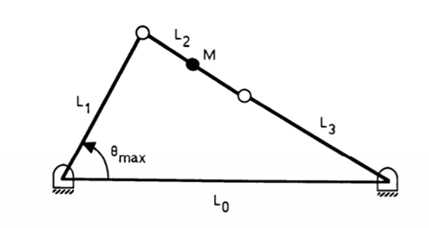
Angle Analysis
The calculation of the limitation angle is done using cosine law. The Law of Cosines (also called the Cosine Rule) says:
c² = a² + b² − 2ab cos(C)
In the case of a Watts linkage, There will be 2 cases of limitation angle-minimum angle condition and a maximum angle condition. Case for maximum angle condition as shown.

Slide 16
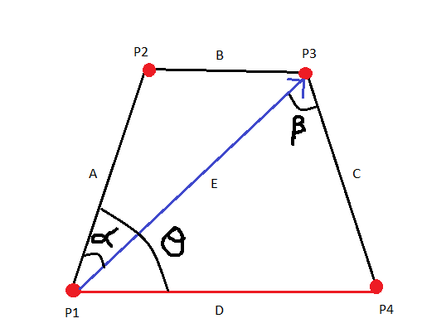
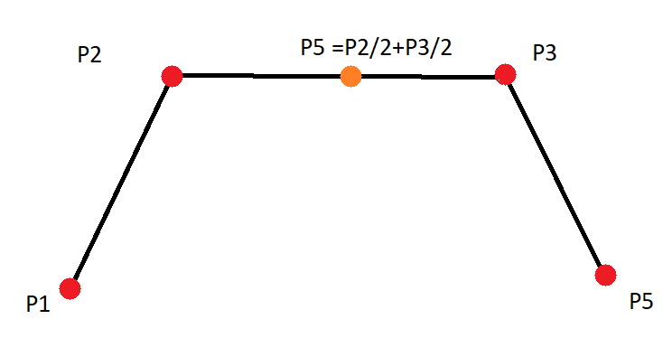
POSITION, VELOCITY AND ACCELERATION ANALYSIS
P1: Coordinates of intersection of crank and fixed link.
P2: Coordinates of intersection of crank and coupler.
P3: Coordinates of intersection of follower and coupler.
P4: Coordinates of intersection of follower and fixed link.
P5: Midpoint of the coupler link and the line of motion of our Watt’s linkage. The coordinates of the points are in the vector format.

Slide 17
DETERMINING LINK JOINTS
When the simulation takes place, the resultant vector of the 4 links E is needed to be taken into consideration.
The angles made by the resultant vector E and the crank & follower should also be taken into consideration as the change in the angles per time will help in easier simulation.
P1 and P4 are points which do not move.We shall fix P1 at the origin and P4 at a distance of D length along the x axis P1=(0,0) and P4=(D,0).
P2 and P3 are points which move with respect to time and to formulate a general simulation it would be easier if we represent P2 and P3 in terms of the angles theta, beta and alfa.
From basic geometric construction we get the following coordinates: P2=(Acos(theta),Asin(theta)) P3=(D - Ccos(alfa+beta),Csin(alfa+beta))
P5 is the midpoint of the line joining P2 and P3(coupler) and is calculated by midpoint theorem. P5=((P2x+P3x)/2,(P2y+P3y)/2)
Notes:
srinath

Slide 18
POSITION,VELOCITY AND ACCELERATION ANALYSIS
The analysis will be done for point P5. The position of P5 will be given by the (x coordinate,y coordinate) i.e., (P5x.P5y) graph.
As per the definition of instantaneous velocity, Velocity at a particular time V=d(r)/dt where r=(P5x,P5y). This generates a velocity matrix of length
2 x length(t) where the first row is P5vx(x component of velocity) and second row is P5vy(y component of velocity)
Similarly for acceleration as per the definition of instantaneous acceleration, Acceleration at a particular time A=d(V)/dt where V=(P5vx,P5vy). This generates an acceleration matrix of length
2 x length(t) where the first row is P5ax (x component of velocity) and second row is P5ay (y component of velocity)
We now have the position, velocity and acceleration of the particle throughout the time of simulation.
Notes:
srinath

Slide 19
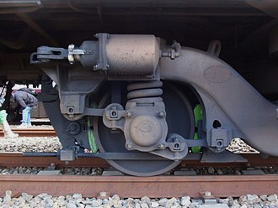
APPLICATIONS OF WATT’S LINKAGE
Used in the rear axle of some car suspensions as an improvement over the Panhard rod. Used to prevent relative sideways motion between the axle and body of the car.
Another application is a double acting piston.

Slide 20
THANK YOU!

